Slide 1
Hess’s Law
ΔH is well known for many reactions, and it is inconvenient to measure ΔH for every reaction in which we are interested.
However, we can estimate ΔH using published ΔH values and the properties of enthalpy.
from known reactions to unknown reactions

Slide 2
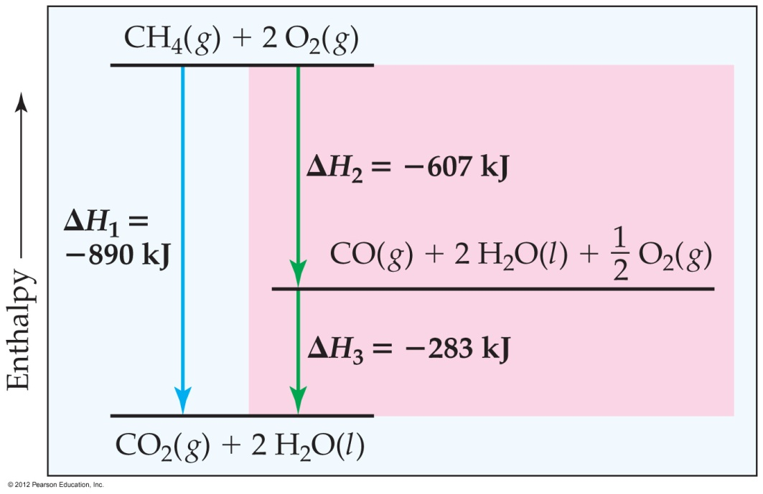
Hess’s Law
Hess’s law states that “if a reaction is carried out in a series of steps, ΔH for the overall reaction will be equal to the sum of the enthalpy changes for the individual steps.”

Slide 3
Hess’s Law
Because ΔH is a state function, the total enthalpy change depends only on the initial state of the reactants and the final state of the products.

Slide 4
Calculation of ΔH
C₃H₈(g) + 5O₂(g) ⎯→ 3CO₂(g) + 4H₂O(l)
C₃H₈(g) ⎯→ 3C_{(graphite)} + 4H₂(g)
3C_{(graphite)} + 3O₂(g) ⎯→3CO₂(g)
4H₂(g) + 2O₂(g) ⎯→ 4H₂O(l)
C₃H₈(g) + 5O₂(g) ⎯→ 3CO₂(g) + 4H₂O(l)

Slide 5
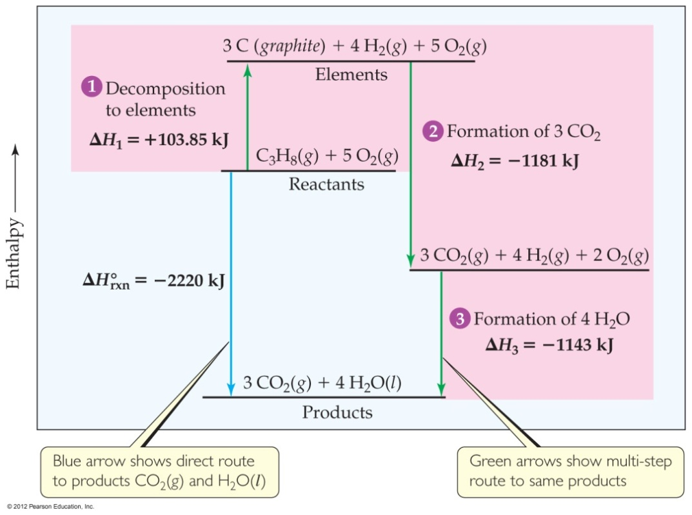
Calculation of ΔH
C₃H₈(g) + 5O₂(g) ⎯→ 3CO₂(g) + 4H₂O(l)
The sum of these equations is
C₃H₈(g) ⎯→ 3C_{(graphite)} + 4H₂(g)
3C_{(graphite)} + 3O₂(g) ⎯→3CO₂(g)
4H₂(g) + 2O₂(g) ⎯→ 4H₂O(l)
C₃H₈(g) + 5O₂(g) ⎯→ 3CO₂(g) + 4H₂O(l)

Slide 6
Calculation of ΔH
We can use Hess’s law in this way:
ΔH = ΣnΔH_{f}º_{,products} – ΣmΔH_{f}º_{,reactants}
where n and m are the stoichiometric coefficients.

Slide 7
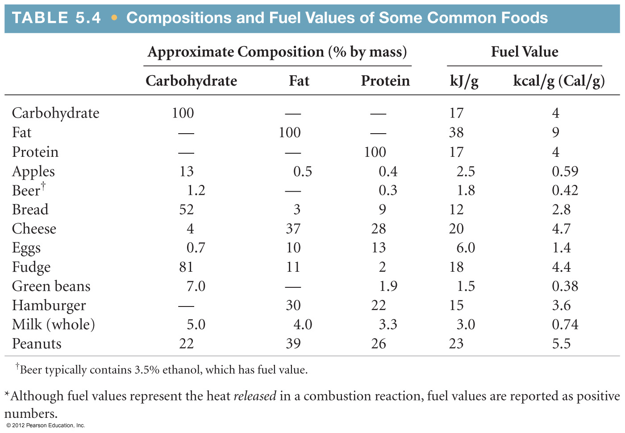
Energy in Foods
Most of the fuel in the food we eat comes from carbohydrates and fats.

Slide 8
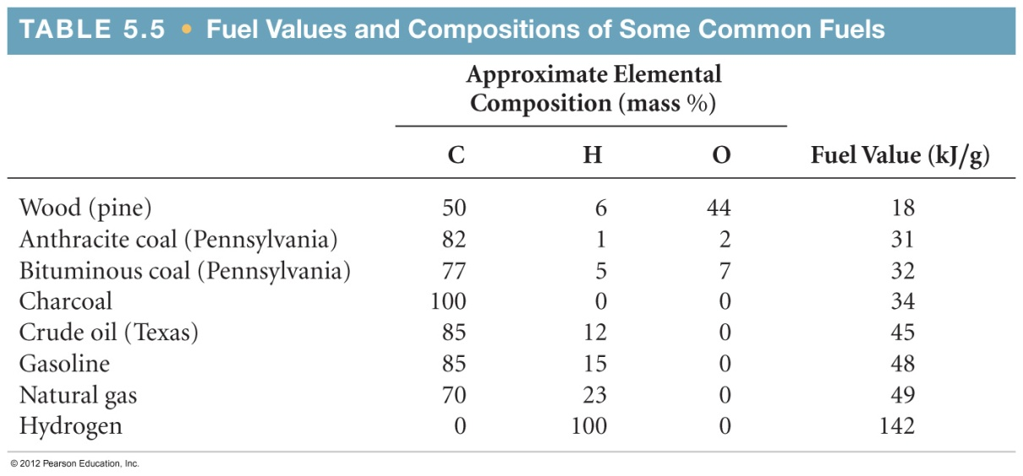
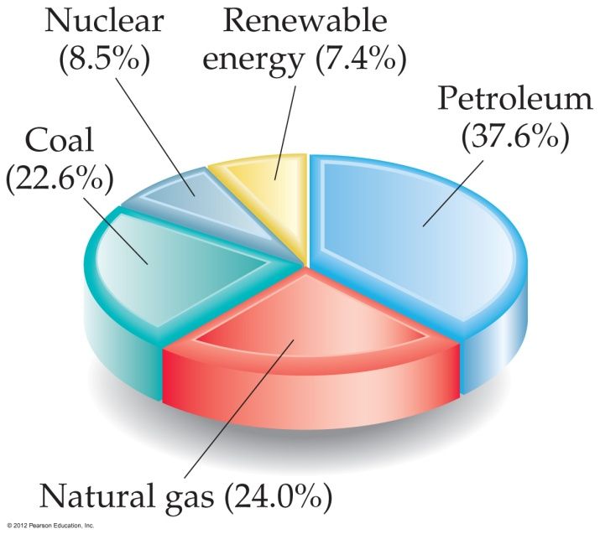
Energy in Fuels
The vast majority of the energy consumed in the USA comes from fossil fuels.

Slide 9

A substance’s specific heat is its heat capacity per
mole.
gram.
joule.
d. kelvin.
Notes:
Answer: b

Slide 10
The standard enthalpy of formation of carbon in its graphite form is _______ kilojoules per mole.
100
1000
1
d. 0
Notes:
Answer: d

Slide 11
The standard enthalpy of formation of carbon in its diamond form is +1.88 kJ/mole, which means that diamond is _______ graphite.
as stable as
more stable than
less stable than
d. an isotope of
Notes:
Answer: c

Slide 12
2 H₂ + O₂ → 2 H₂O If the reaction above releases 483.6 kJ, then the standard enthalpy of formation of H₂O =
–483.6 kJ/mole.
+483.6 kJ/mole.
–241.8 kJ/mole.
d. +241.8 kJ/mole.
Notes:
Answer: c

Slide 13
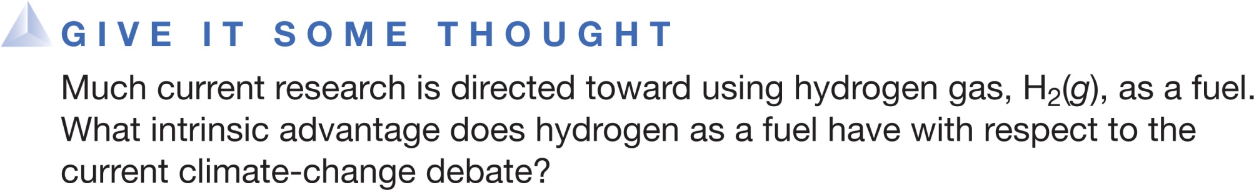
It is easily stored as a gas for a long time.
Its product of combustion is only H₂O(g).
Safety considerations using hydrogen gas are minimal.
It is easily found in nature as an element.
Notes:
Answer: B

Slide 14
The average fuel values for proteins, carbohydrates, and fats are, respectively, _______ kilocalories per gram.
4, 4, and 4
4, 4, and 9
4, 9, and 4
d. 9, 4, and 4
Notes:
Answer: b

Slide 15
Energy
Chemical Energy
Breaking old bond(s) in the reactants
while making new bond(s) in the products

Slide 16

Lecture Presentation
Chapter 6 Electronic Structure of Atoms
Electronic configuration
James F. Kirby
Quinnipiac University
Hamden, CT

Slide 17
ATOMIC STRUCTURE
-
trouble makers – responsible for chemical reactions!
nucleus
-
proton
-
6P+
-
6N
-
-
neutron
electron
-

Slide 18
isoelectronic
₁₀Ne
₁₈Ar
₁₁Na (1s²2s²2p⁶3s¹)
₁₇Cl(1s²2s²2p⁶3s²3p⁵)
proton
₁₇Cl(1s²2s²2p⁶3s²3p⁶)
₁₇Cl⁻
₁₁Na (1s²2s²2p⁶3s⁰)
₁₁Na⁺
11
17
electron
₁₁Na⁺
₁₇Cl⁻
NaCl

Slide 19
Electronic Structure
This chapter is all about electronic structure—the arrangement and energy of electrons.
Arrangement – where are they located with respect to the nucleus?
Energy – how energetic are they (core or valence electrons)?
Any similarity between elements? – determined by similar electronic structure – periodicity (CHAPTER 7)

Slide 20
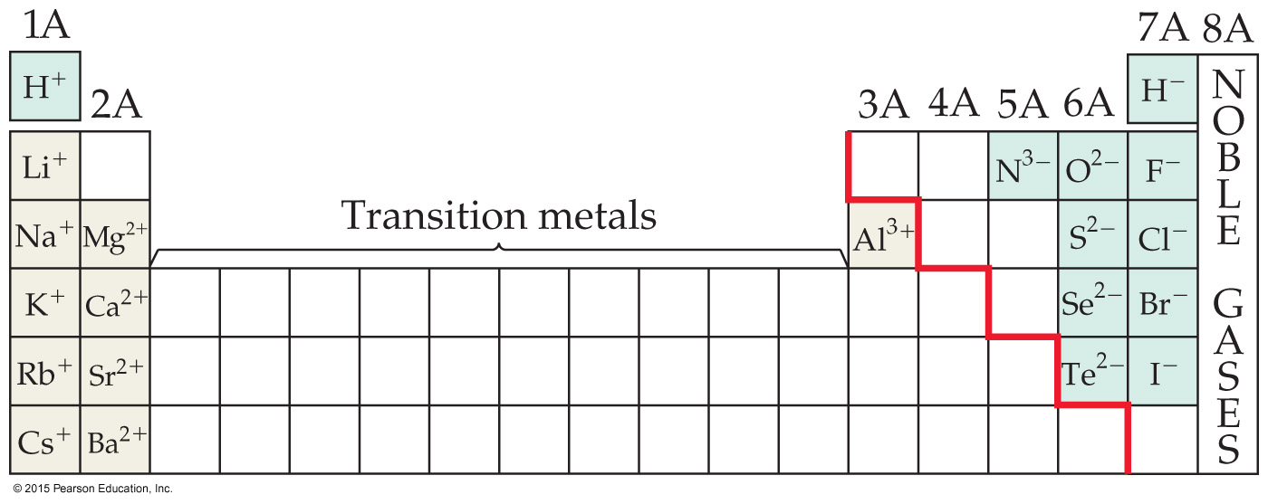
Periodic Table - Periodicity

Slide 21
Pauli Exclusion Principle
No two electrons in the same atom can have exactly the same energy.
Therefore, no two electrons in the same atom can have identical sets of quantum numbers.
This means that every electron in an atom must differ by at least one of the four quantum number values: n, l, m_{l}, and m_{s}.

Slide 22
Electron Configurations
4p⁵
The way electrons are distributed in an atom is called its electron configuration.
The most stable organization is the lowest possible energy, called the ground state.
Each component consists of
a number denoting the energy level;
a letter denoting the type of orbital;
a superscript denoting the number of electrons in those orbitals.

Slide 23
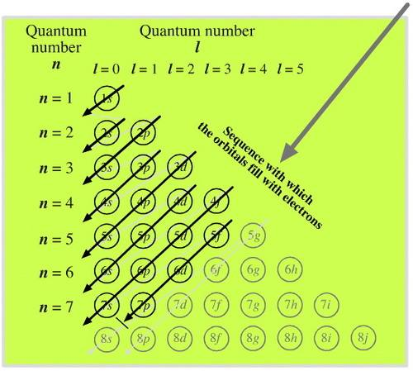
Electron Configurations
The aufbau principle - electrons fill atomic orbitals of the lowest available energy levels before occupying higher levels

Slide 24
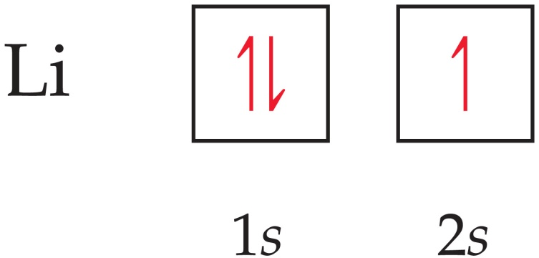
Orbital Diagrams
Each box in the diagram represents one orbital.
Half-arrows represent the electrons.
The direction of the arrow represents the relative spin of the electron.

Slide 25
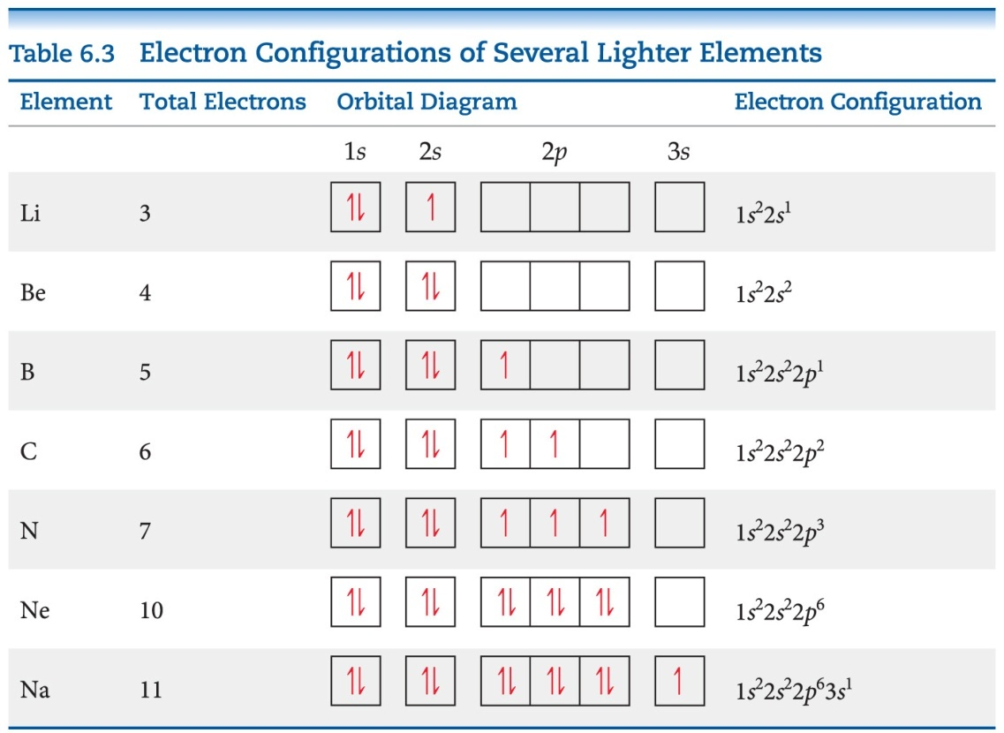
Hund’s Rule
“For degenerate orbitals, the lowest energy is attained when the number of electrons with the same spin is maximized.”
This means that, for a set of orbitals in the same sublevel, there must be one electron in each orbital before pairing and the electrons have the same spin, as much as possible.

Slide 26
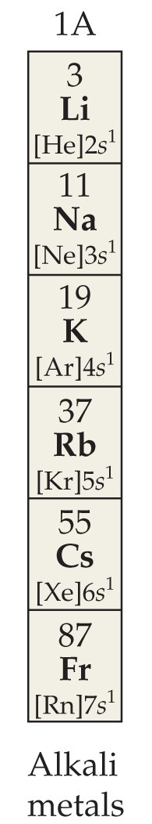
Condensed Electron Configurations
Elements in the same group of the periodic table have the same number of electrons in the outer most shell. These are the valence electrons.
The filled inner shell electrons are called core electrons. These include completely filled d or f sublevels.
We write a shortened version of an electron configuration using brackets around a noble gas symbol and listing only valence electrons.

Slide 27
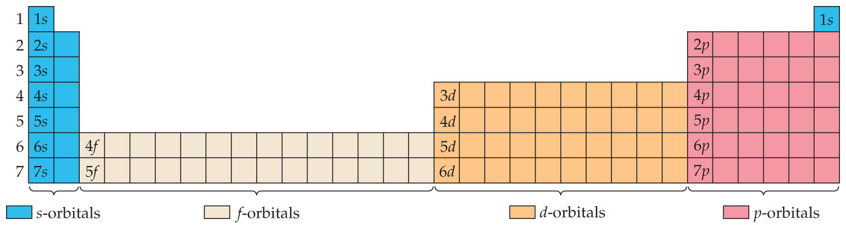
Periodic Table
We fill orbitals in increasing order of energy.
Different blocks on the periodic table correspond to different types of orbitals: s = blue, p = pink (s and p are representative elements); d = orange (transition elements); f = tan (lanthanides and actinides, or inner transition elements)

Slide 28
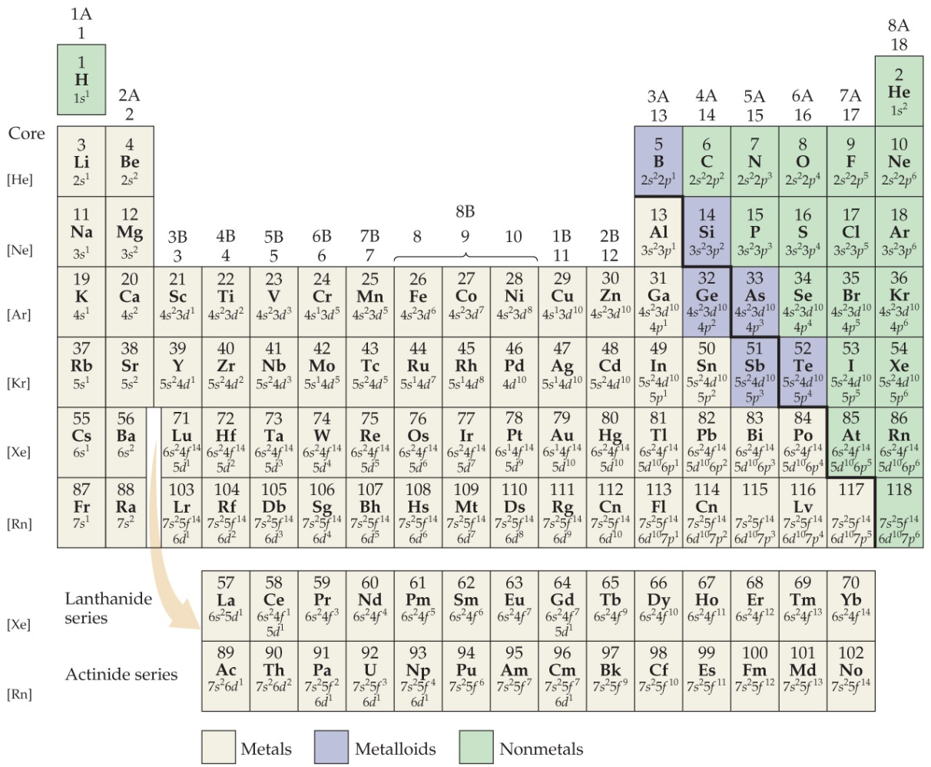
Some Anomalies
Some irregularities occur when there are enough electrons to half-fill s and d orbitals on a given row.

Slide 29
Chromium as an Anomaly
For instance, the electron configuration for chromium is
[Ar] 4s¹ 3d⁵
rather than the expected
[Ar] 4s² 3d⁴.
This occurs because the 4s and 3d orbitals are very close in energy.
These anomalies occur in f-block atoms with f and d orbitals, as well.

Slide 30
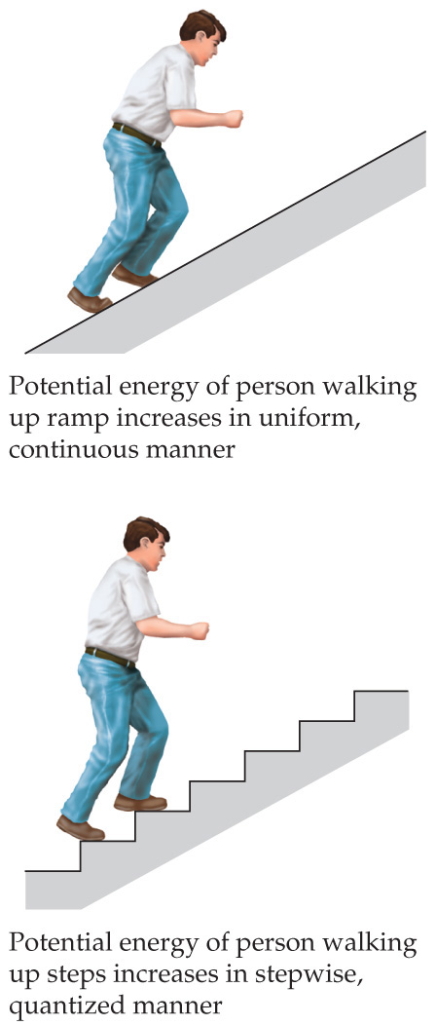
The Nature of Energy—Quanta
Max Planck explained it by assuming that energy comes in packets called quanta (singular: quantum).

Slide 31
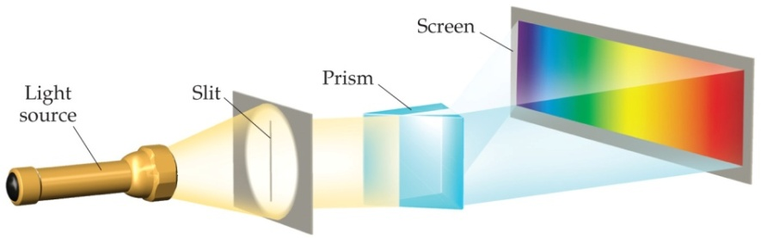
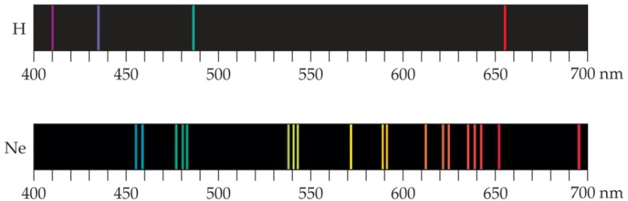
Continuous vs. Line Spectra
For atoms and molecules, one does not observe a continuous spectrum (the “rainbow”), as one gets from a white light source.
Only a line spectrum of discrete wavelengths is observed. Each element has a unique line spectrum.

Slide 32

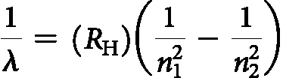
The Hydrogen Spectrum
Johann Balmer (1885) discovered a simple formula relating the four lines to integers.
Johannes Rydberg advanced this formula.
Neils Bohr explained why this mathematical relationship works.

Slide 33
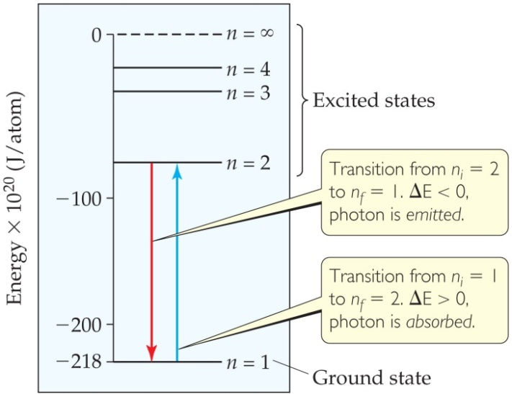
The Bohr Model
Niels Bohr adopted Planck’s assumption and explained these phenomena in this way:
Electrons in an atom can only occupy certain orbits (corresponding to certain energies).

Slide 34
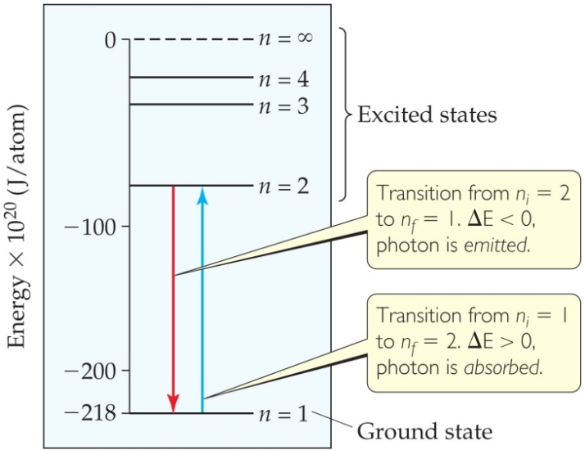
The Bohr Model
Electrons in permitted orbits have specific, “allowed” energies; these energies will not be radiated from the atom.
Energy is only absorbed or emitted in such a way as to move an electron from one “allowed” energy state to another; the energy is defined by
E = hν

Slide 35
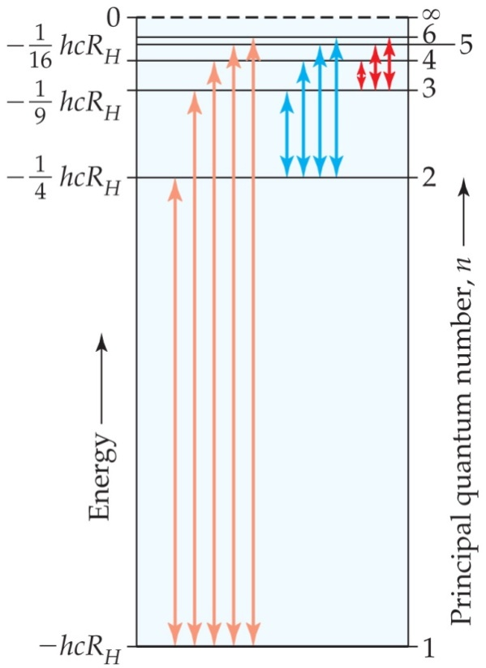
The Bohr Model
The energy absorbed or emitted from the process of electron promotion or demotion can be calculated by the equation
1
n_{f}²
1
n_{i}²
( )
ΔE = −hcR_{H}
–
where R_{H} is the Rydberg constant, 1.097 × 10⁷ m⁻¹, and n_{i} and n_{f} are the initial and final energy levels of the electron.

Slide 36
Important Ideas from the Bohr Model
Points that are incorporated into the current atomic model include the following:
Electrons exist only in certain discrete
energy levels （energy is quantized）.
2) Energy is involved in the transition of
an electron from one level to another.

Slide 37
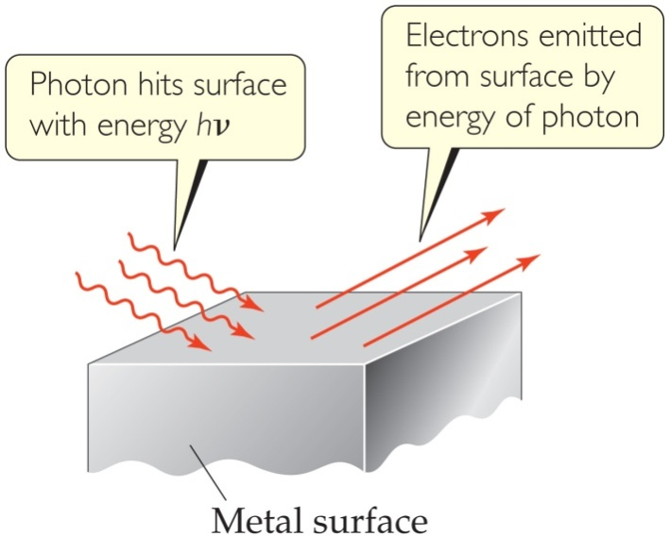
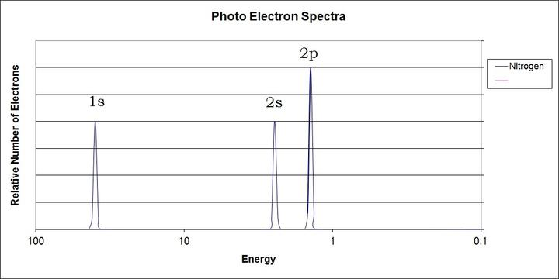
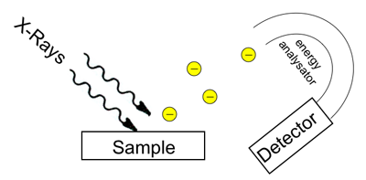
The Photoelectric Effect
Einstein used quanta to explain the photoelectric effect.
Each metal has a different energy at which it ejects electrons. At lower energy, electrons are not emitted.
He concluded that energy is proportional to frequency:
E = hν, where h is Planck’s constant, 6.626 × 10⁻³⁴ J∙s.

Slide 38
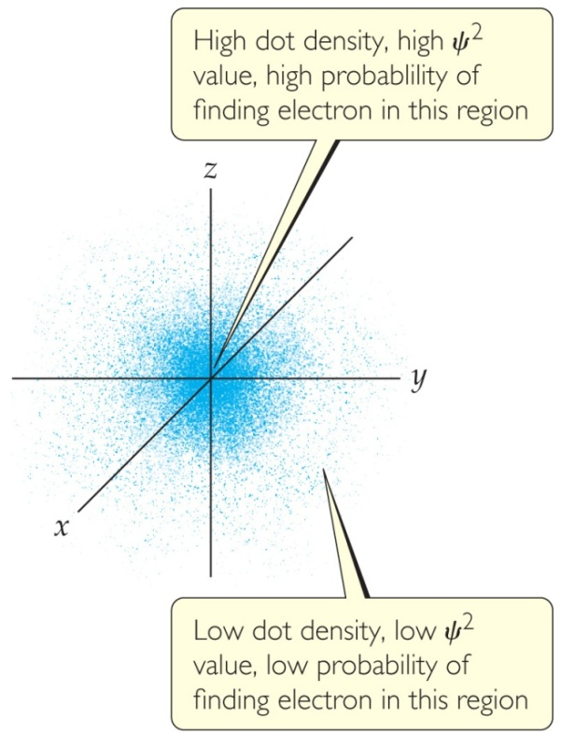
Quantum Mechanics
Erwin Schrödinger developed a mathematical treatment into which both the wave and particle nature of matter could be incorporated.
This is known as quantum mechanics.

Slide 39
Quantum Mechanics
The solution of Schrödinger’s wave equation is designated with a lowercase Greek psi (ψ).
The square of the wave equation, ψ², gives the electron density, or probability of where an electron is likely to be at any given time.

Slide 40
Quantum Numbers
Solving the wave equation gives a set of wave functions, or orbitals, and their corresponding energies.
Each orbital describes a spatial distribution of electron density.
An orbital is described by a set of three quantum numbers.

Slide 41
An Atom versus a House
How many stories? – shells/orbitals (principal)
How many different room designs on the same floor? – subshells (angular momentum)
How are the rooms of the same design oriented? (magnetic)

Slide 42
Principal Quantum Number (n)
The principal quantum number, n, describes the energy level on which the orbital resides.
The values of n are integers ≥ 1.
These correspond to the values in the Bohr model.

Slide 43
Angular Momentum Quantum Number (l)
This quantum number defines the shape of the orbital.
Allowed values of l are integers ranging from 0 to n − 1.
We use letter designations to communicate the different values of l and, therefore, the shapes and types of orbitals.

Slide 44
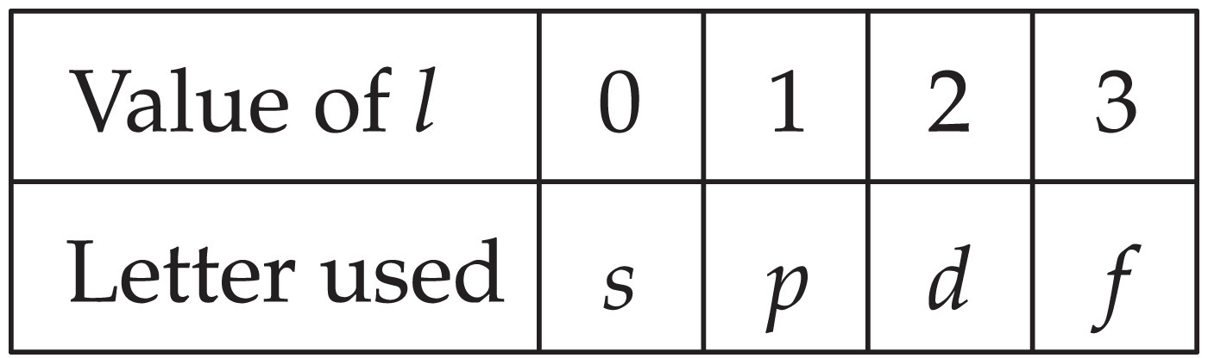
Angular Momentum Quantum Number (l)

Slide 45
Magnetic Quantum Number (m_{l})
The magnetic quantum number describes the three-dimensional orientation of the orbital.
Allowed values of m_{l} are integers ranging from −l to l:
−l ≤ m_{l} ≤ l
Therefore, on any given energy level, there can be up to 1 s orbital, 3 p orbitals, 5 d orbitals, 7 f orbitals, and so forth.

Slide 46
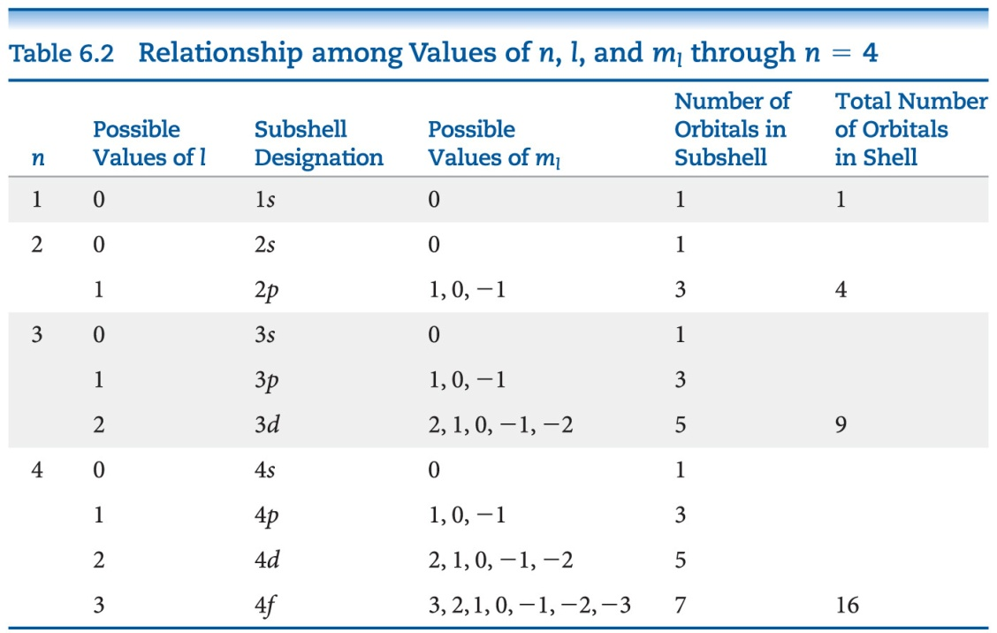
Magnetic Quantum Number (m_{l})
Orbitals with the same value of n form an electron shell.
Different orbital types within a shell are subshells.

Slide 47
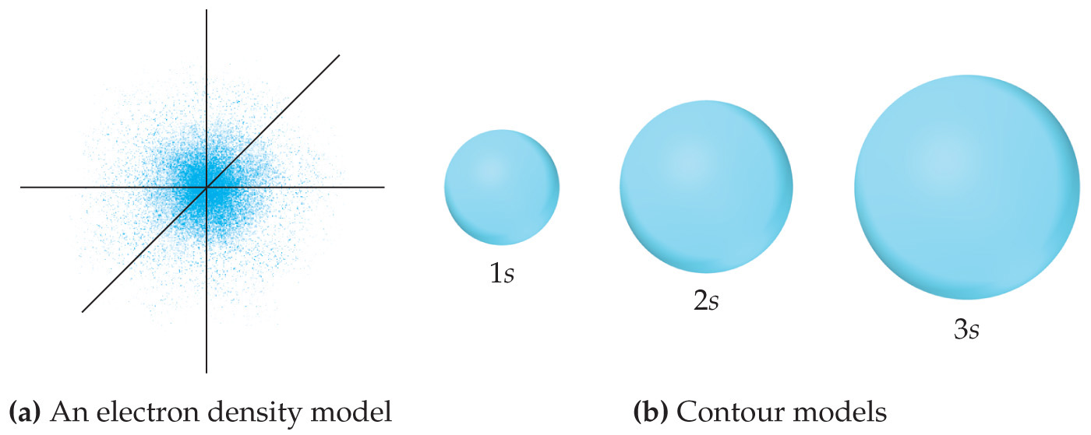
s Orbitals
The value of l for s orbitals is 0.
They are spherical in shape.
The radius of the sphere increases with the value of n.

Slide 48
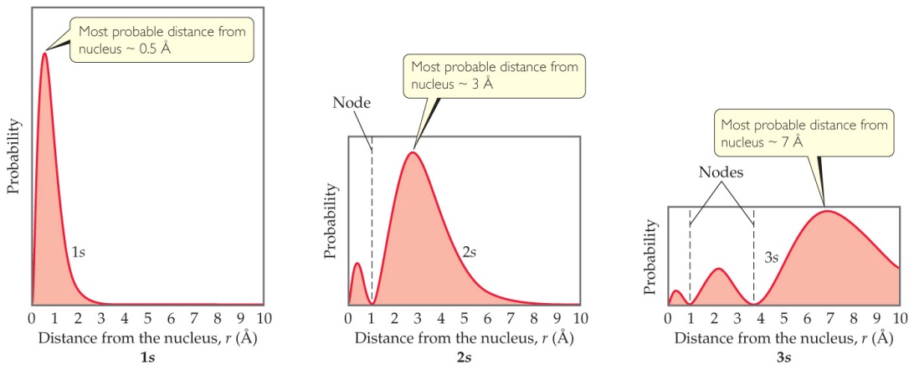
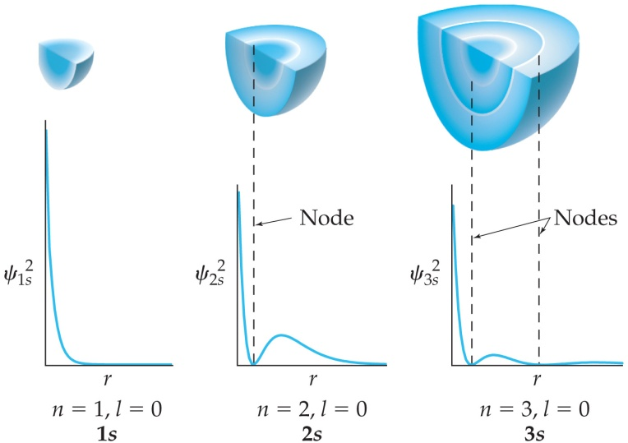
s Orbitals
For an ns orbital, the number of peaks is n.
For an ns orbital, the number of nodes (where there is zero probability of finding an electron) is n – 1.
As n increases, the electron density is more spread out and there is a greater probability of finding an electron further from the nucleus.

Slide 49
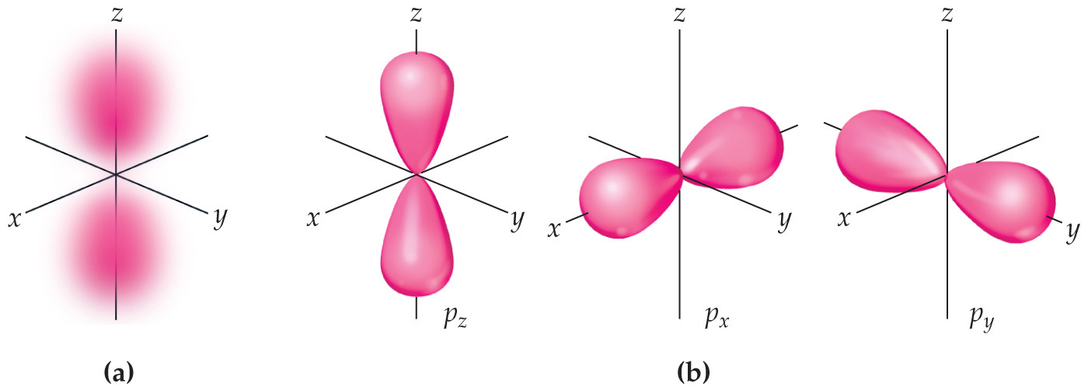
p Orbitals
The value of l for p orbitals is 1.
They have two lobes with a node between them.

Slide 50
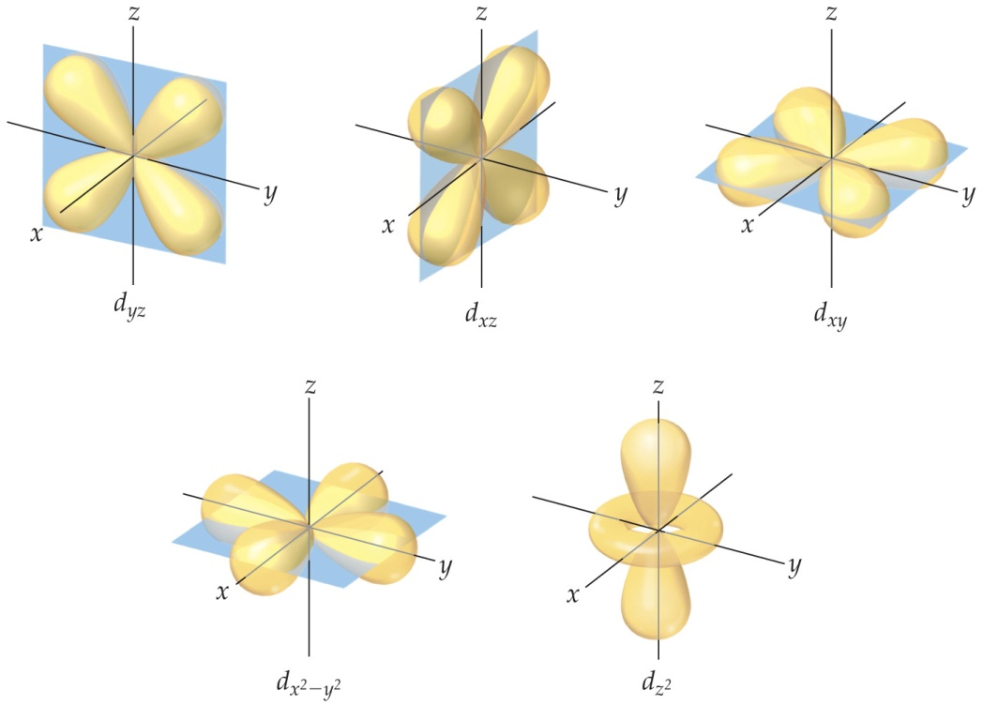
d Orbitals
The value of l for a d orbital is 2.
Four of the five d orbitals have four lobes; the other resembles a p orbital with a doughnut around the center.

Slide 51
f Orbitals
Very complicated shapes (not shown in text)
Seven equivalent orbitals in a sublevel
l = 3

Slide 52
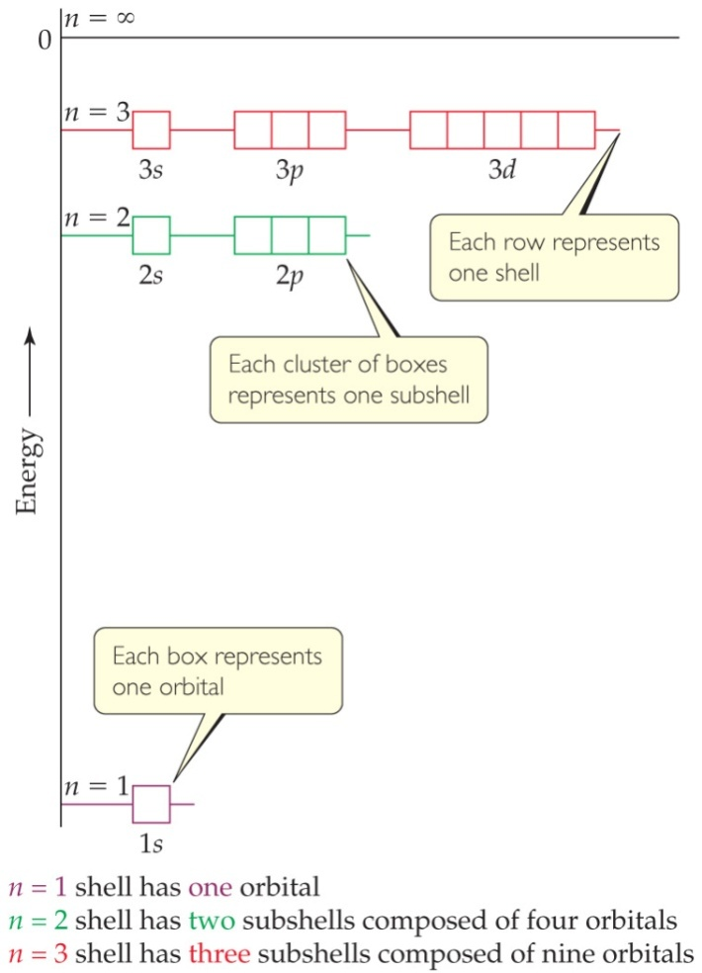
Energies of Orbitals—Hydrogen
For a one-electron hydrogen atom, orbitals on the same energy level have the same energy.
Chemists call them degenerate orbitals.

Slide 53
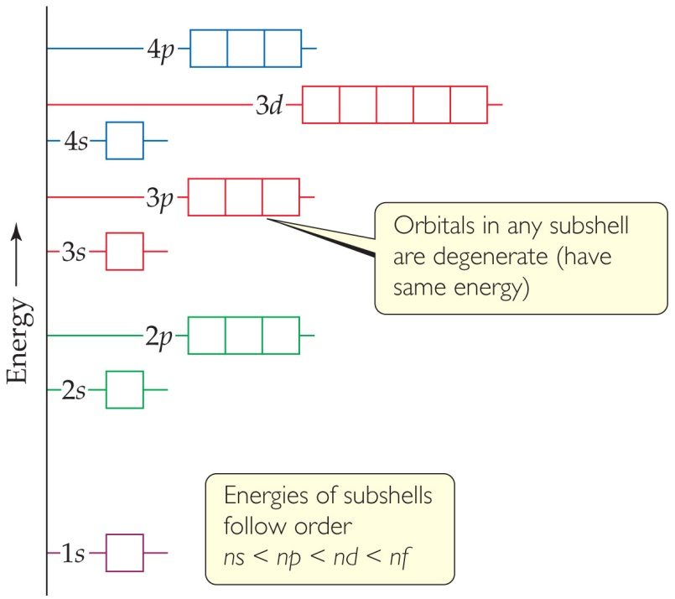
Energies of Orbitals—Many-electron Atoms
As the number of electrons increases, so does the repulsion between them.
Therefore, in atoms with more than one electron, not all orbitals on the same energy level are degenerate.
Orbital sets in the same sublevel are still degenerate.
Energy levels start to overlap in energy (e.g., 4s is lower in energy than 3d.)

Slide 54
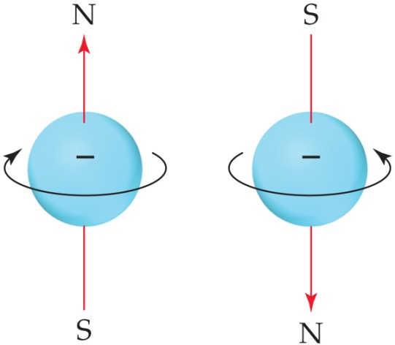
Spin Quantum Number, m_{s}
In the 1920s, it was discovered that two electrons in the same orbital do not have exactly the same energy.
The “spin” of an electron describes its magnetic field, which affects its energy.
This led to the spin quantum number, m_{s}.
The spin quantum number has only two allowed values, +½ and –½.

